Slide 1
Unicast Routing
Protocols
(RIP, OSPF, BGP)

Slide 2
CONTENTS
INTERIOR AND EXTERIOR ROUTING
RIP
OSPF
BGP

Slide 3
INTERIOR (Intradomain)
AND
EXTERIOR (Interdomain)
ROUTING

Slide 4
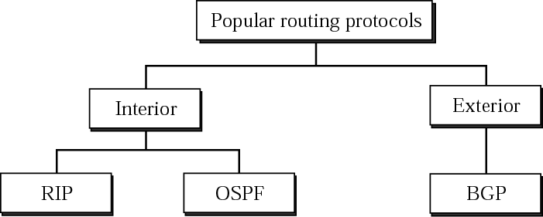
Popular routing protocols
Distance Vector
Link State
Path Vector

Slide 5
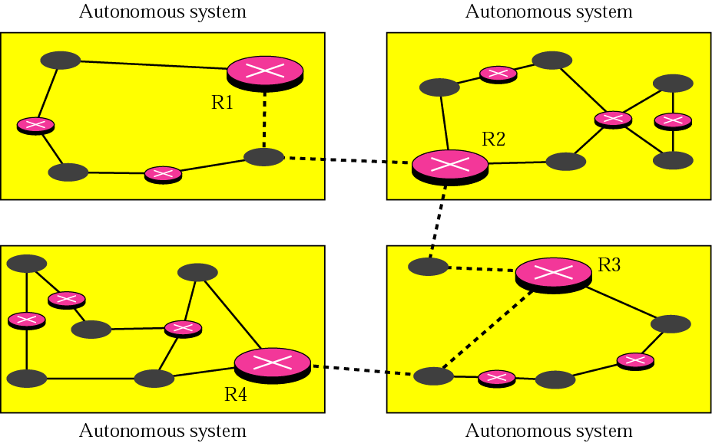
Autonomous systems

Slide 6
RIP:
Routing
Information
Protocol

Slide 7
The Routing Information Protocol (RIP) is an intradomain (interior) routing protocol used inside an autonomous system.
It is a very simple protocol based on distance vector routing.
RIP implementation consideration:
  In an autonomous system, we are dealing with routers and networks (links)
  The destination in a routing table is a network, which means the first column defines a network address.
  The metric used by RIP is very simple; the distance is defined as the number of links (networks) that have to be used to reach the destination. For this reason, the metric in RIP is called a hop count
  Infinity is defined as 16, ie cannot have more than 15 hops.
  The next node column defines the address of the router to which the packet is to be sent to reach its destination.

Slide 8
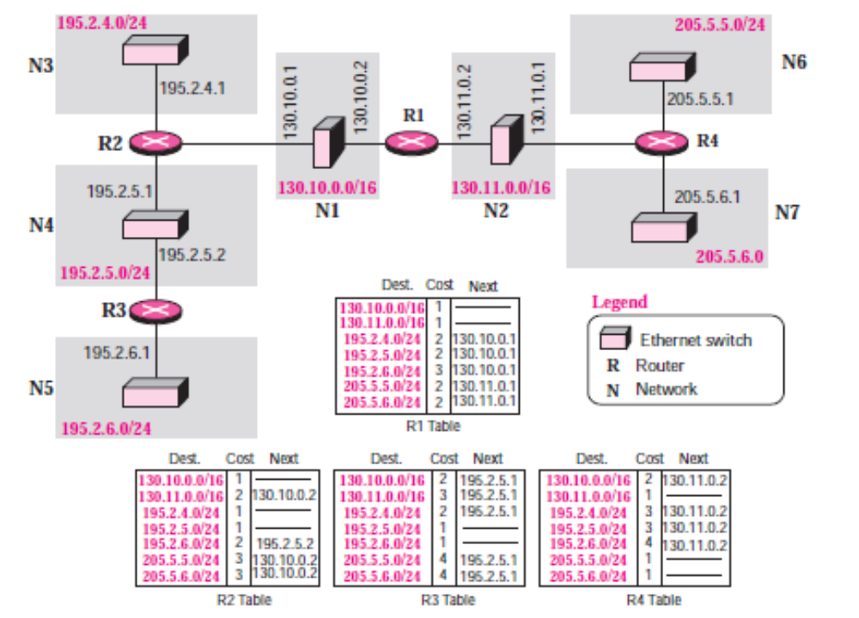
Example of a domain using RIP

Slide 9
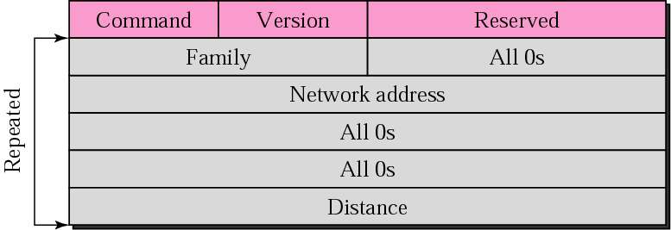
RIP message format

Slide 10
Command. This 8-bit field specifies the type of message: request (1) or response (2).
Version. This 8-bit field defines the version
Family. This 16-bit field defines the family of the protocol used. For TCP/IP the value is 2.
Network address. The address field defines the address of the destination network. RIP has allocated 14 bytes for this field to be applicable to any protocol. However, IP currently uses only 4 bytes. The rest of the address is filled with 0s.
Distance. This 32-bit field defines the hop count (cost) from the advertising router to the destination network.

Slide 11
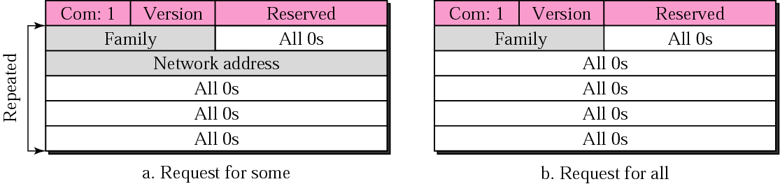
Request and Responses messages
Request Message:
A request message is sent by a router that has just come up or by a router that has sometime-out entries.
A request can ask about specific entries or all entries.

Slide 12
Response Message:
A response can be either solicited or unsolicited.
  A solicited response is sent only in answer to a request. It contains information about the destination specified in the corresponding request.
  An unsolicited response, on the other hand, is sent periodically, every 30 seconds or when there is a change in the routing table. The response is sometimes called an update packet

Slide 13
Example 1
What is the periodic response sent by router R1 in Figure 13.8 (next slide)? Assume R1 knows about the whole autonomous system.

Slide 14
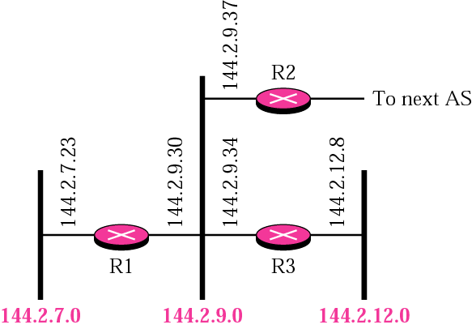
Figure 13-8
Example 1

Slide 15
Solution
R1 can advertise three networks 144.2.7.0, 144.2.9.0, and 144.2.12.0. The periodic response (update packet) is shown in Figure 13.9 (next slide).

Slide 16
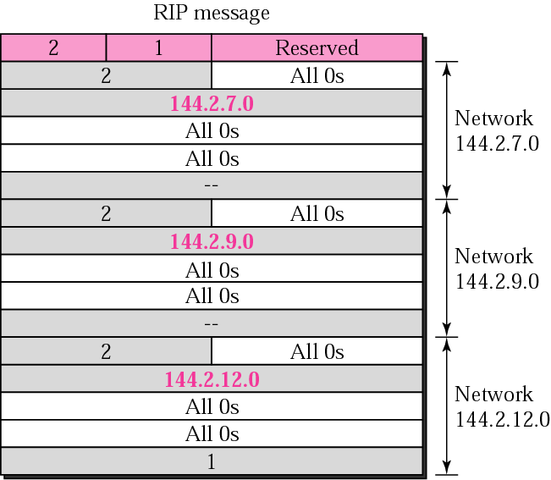
Figure 13-9
Solution to Example 1

Slide 17
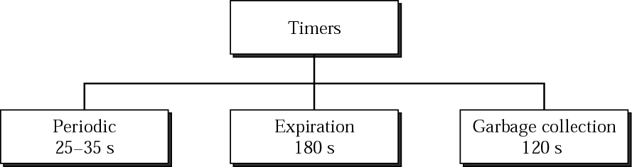
Figure 13-10
RIP timers

Slide 18
Example 2
A routing table has 20 entries. It does not receive information about five routes for 200 seconds. How many timers are running at this time?

Slide 19
Solution
The timers are listed below:
Periodic timer: 1
Expiration timer: 20 − 5 = 15
Garbage collection timer: 5

Slide 20
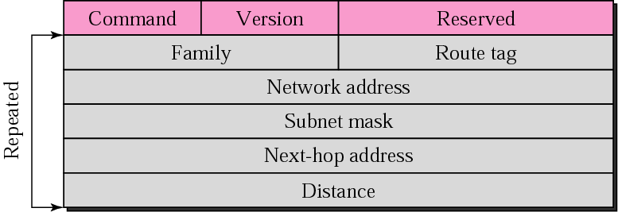
RIP-v2 Format

Slide 21
Route tag. This field carries information such as the autonomous system number. It can be used to enable RIP to receive information from an interdomain routing protocol.
Subnet mask. This is a 4-byte field that carries the subnet mask (or prefix). This means that RIP2 supports classless addressing and CIDR.
Next-hop address. This field shows the address of the next hop. This is particularly useful if two autonomous systems share a network (a backbone, for example).Then the message can define the router, in the same autonomous system or another autonomous system, to which the packet next goes.

Slide 22

RIP version 2 supports
CIDR.

Slide 23
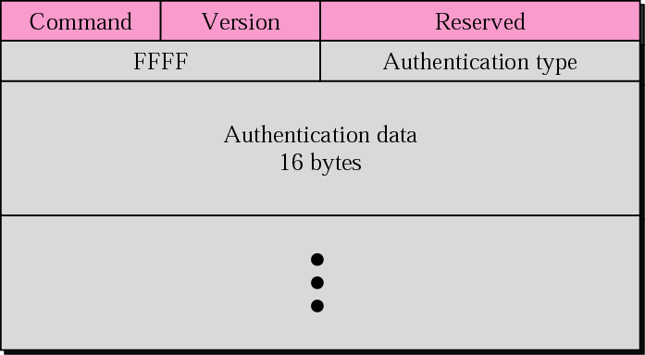
Authentication
Notes:
Authentication
Authentication is added to protect the message against unauthorized advertisement. No
new fields are added to the packet; instead, the first entry of the message is set aside for
authentication information. To indicate that the entry is authentication information and not
routing information, the value of FFFF16 is entered in the family field
The second field, the authentication type, defines the protocol used for authentication,
and the third field contains the actual authentication data.

Slide 24
RIP uses the services of UDP
on well-known port 520.
Notes:
Multicasting
Version 1 of RIP uses broadcasting to send RIP messages to every neighbor. In this
way, all the routers on the network receive the packets, as well as the hosts. RIP version 2,
on the other hand, uses the all-router multicast address to send the RIP messages only
to RIP routers in the network.
Encapsulation
RIP messages are encapsulated in UDP user datagrams. A RIP message does not
include a field that indicates the length of the message. This can be determined from the
UDP packet. The well-known port assigned to RIP in UDP is port 520.

Slide 25
OSPF:
Open Shortest
Path First

Slide 26
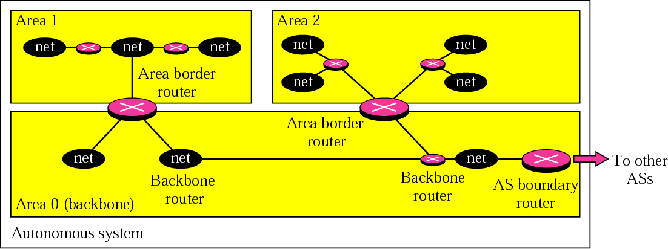
Figure 13-18
Areas in an autonomous system

Slide 27
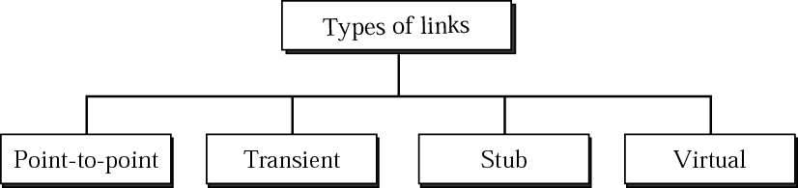
Figure 13-19
Types of links

Slide 28
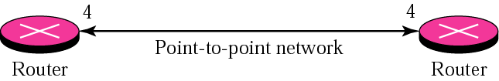
Figure 13-20
Point-to-point link

Slide 29
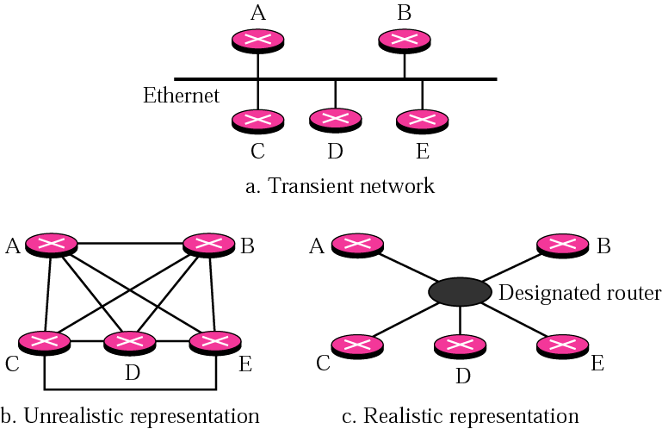
Figure 13-21
Transient link

Slide 30
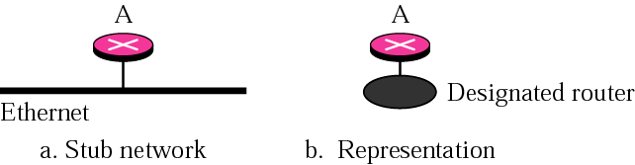
Figure 13-22
Stub link

Slide 31
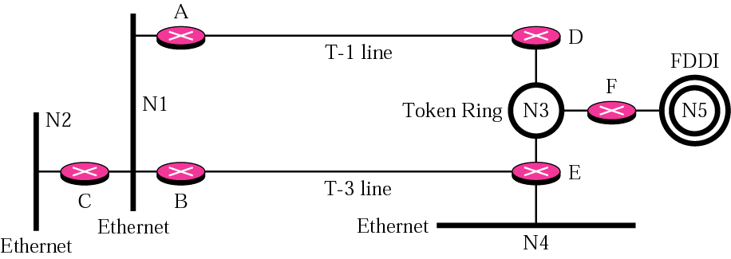
Figure 13-23
Example of an internet

Slide 32
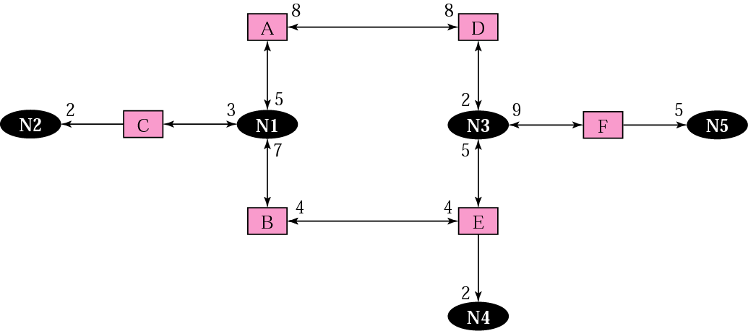
Figure 13-24
Graphical representation of an internet

Slide 33
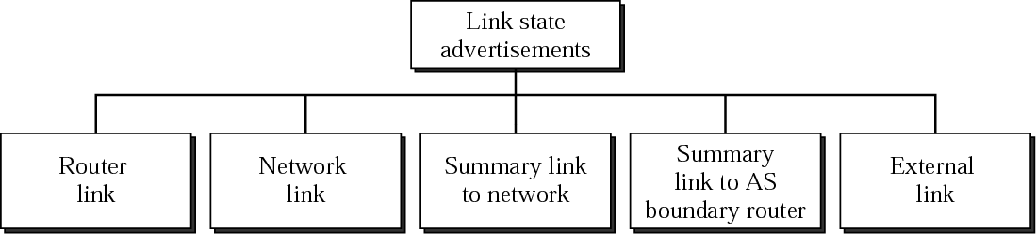
Figure 13-25
Types of LSAs

Slide 34
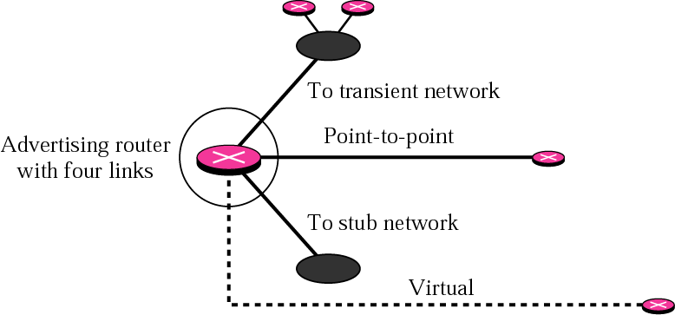
Figure 13-26
Router link

Slide 35
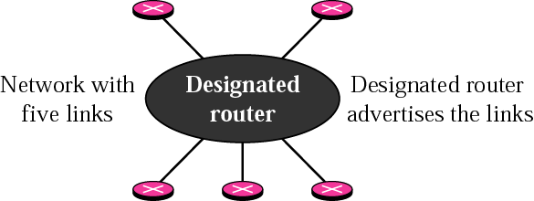
Figure 13-27
Network link

Slide 36
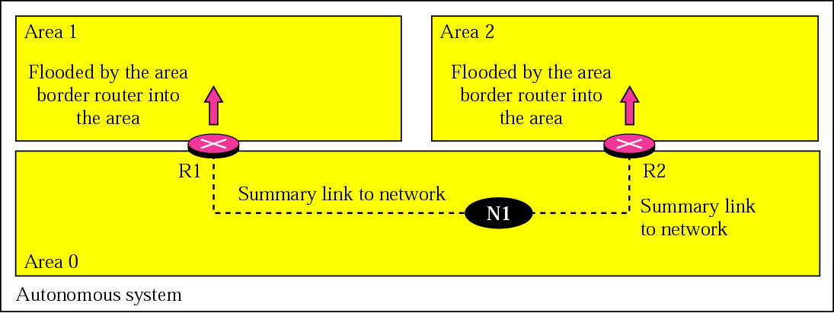
Figure 13-28
Summary link to network

Slide 37
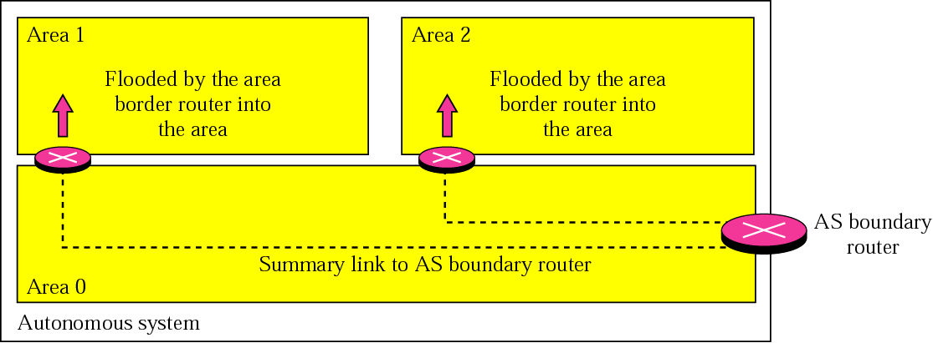
Figure 13-29
Summary link to AS boundary router

Slide 38
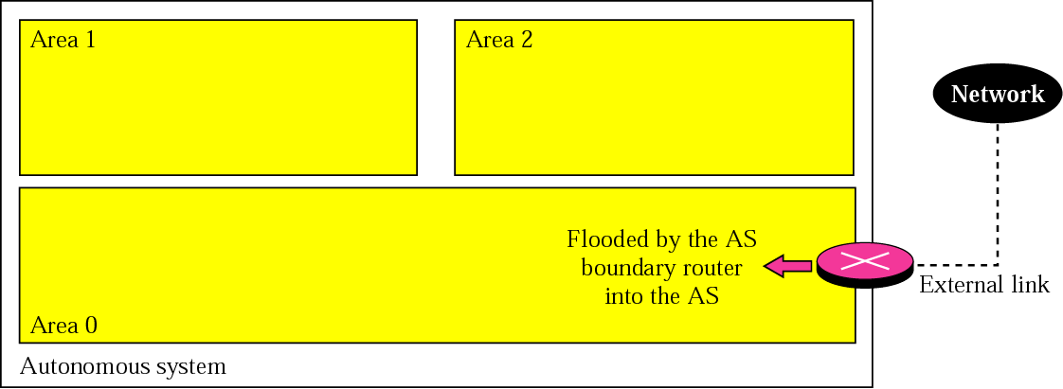
Figure 13-30
External link

Slide 39
Example 3
In Figure 13.31 (next slide), which router(s) sends out router link LSAs?

Slide 40
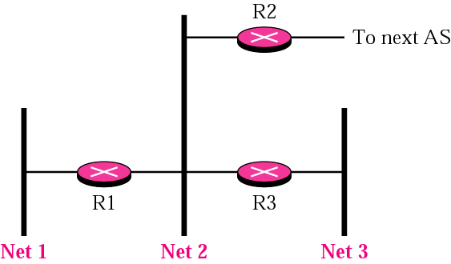
Figure 13-31
Example 3 and Example 4

Slide 41
Solution
All routers advertise router link LSAs.
R1 has two links, Net1 and Net2.
R2 has one link, Net1 in this AS.
R3 has two links, Net2 and Net3.

Slide 42
Example 4
In Figure 13.31, which router(s) sends out the network link LSAs?

Slide 43
Solution
All three network must advertise network links:
Advertisement for Net1 is done by R1 because it is the only router and therefore the designated router.
Advertisement for Net2 can be done by either R1, R2, or R3, depending on which one is chosen as the designated router.
Advertisement for Net3 is done by R3 because it is the only router and therefore the designated router.

Slide 44
In OSPF, all routers have
the same link state database.

Slide 45
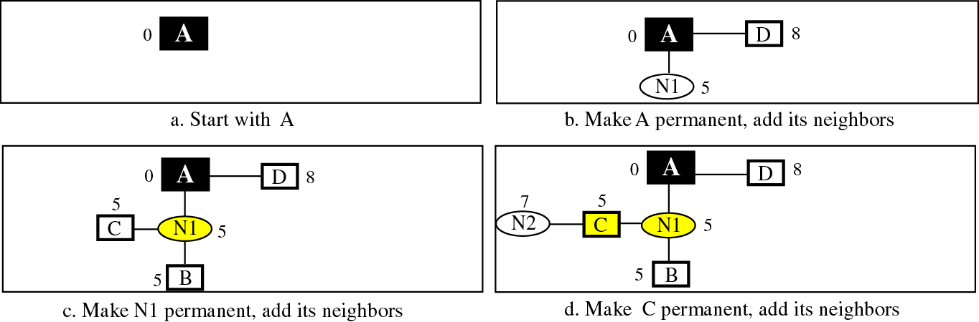
Figure 13-32-Part 1
Shortest path calculation

Slide 46
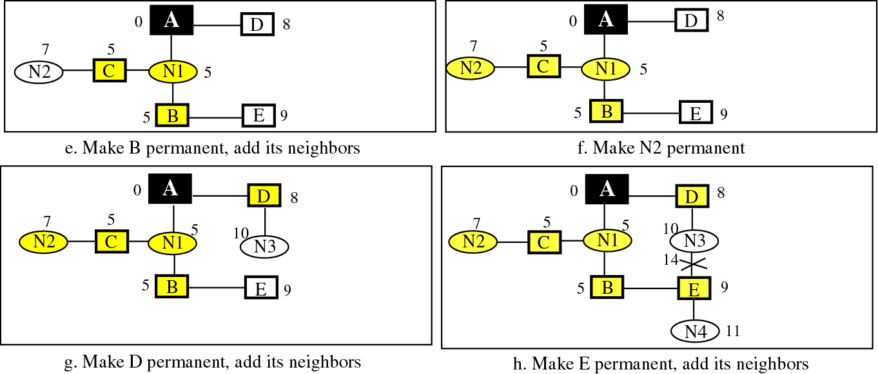
Figure 13-32-Part 2
Shortest path calculation

Slide 47
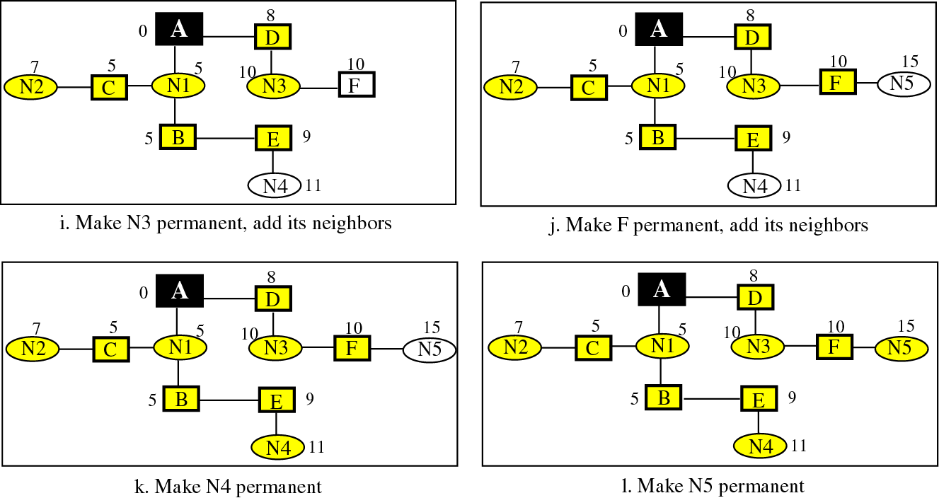
Figure 13-32 Part 3
Shortest path calculation

Slide 48
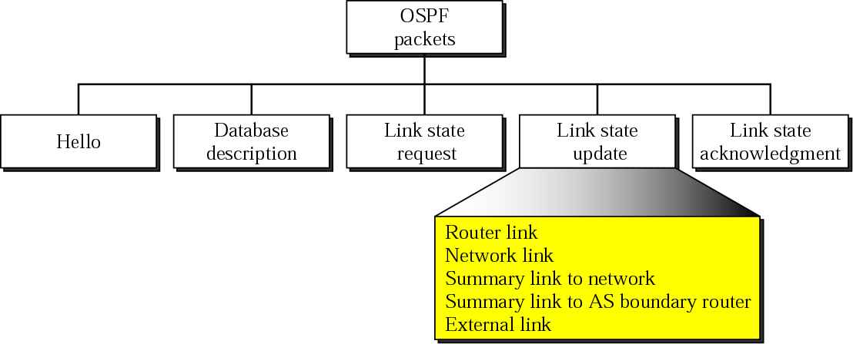
Figure 13-33
Types of OSPF packets

Slide 49
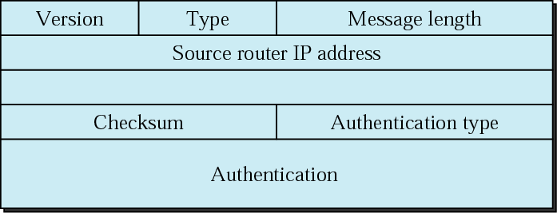
Figure 13-34
OSPF packet header

Slide 50
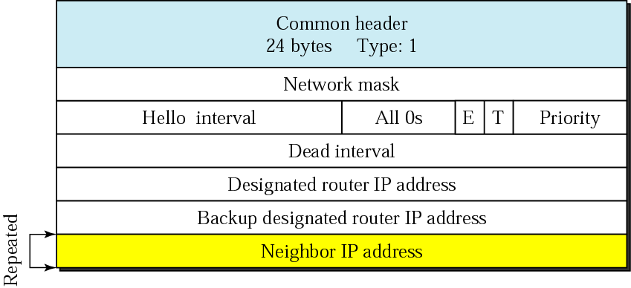
Figure 13-35
Hello packet

Slide 51
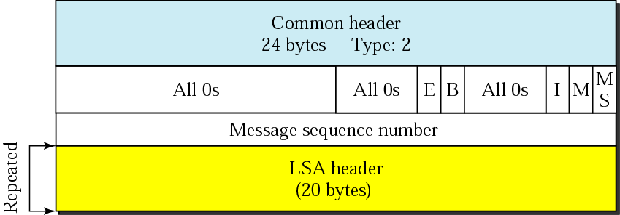
Figure 13-36
Database description packet

Slide 52
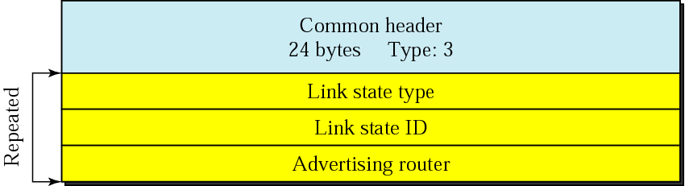
Figure 13-37
Link state request packet

Slide 53
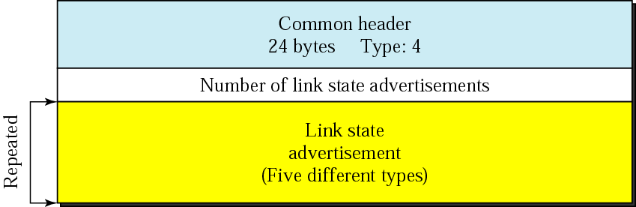
Figure 13-38
Link state update packet

Slide 54
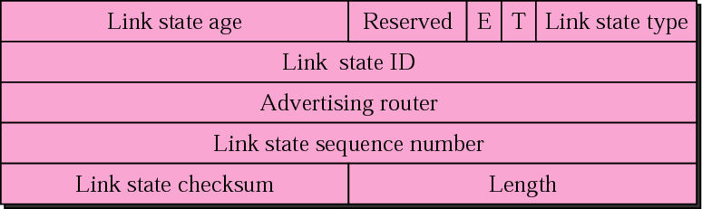
Figure 13-39
LSA header

Slide 55
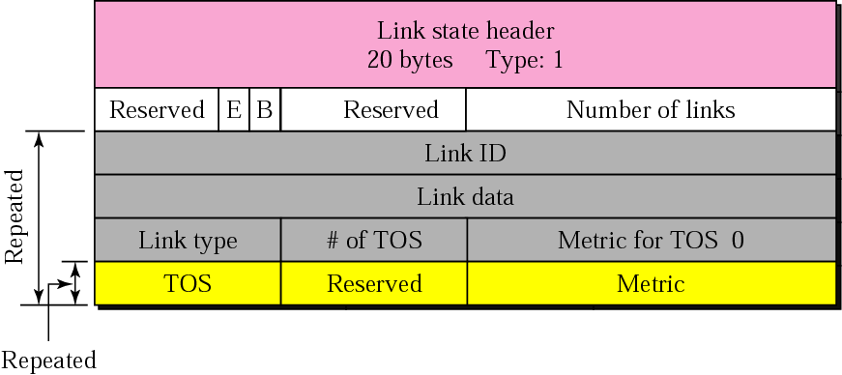
Figure 13-40
Router link LSA

Slide 56
Example 5
Give the router link LSA sent by router 10.24.7.9 in Figure 13.41.

Slide 57
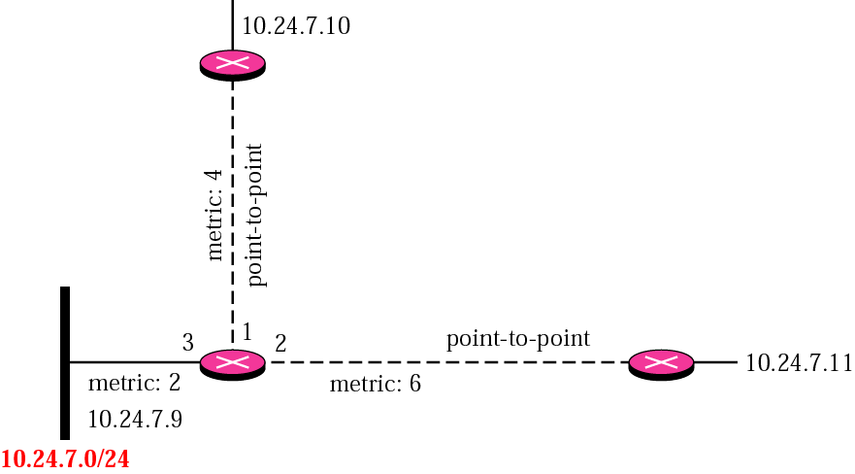
Figure 13-41
Example 5

Slide 58
Solution
This router has three links: two of type 1 (point-to-point) and one of type 3 (stub network). Figure 13.42 shows the router link LSA.

Slide 59
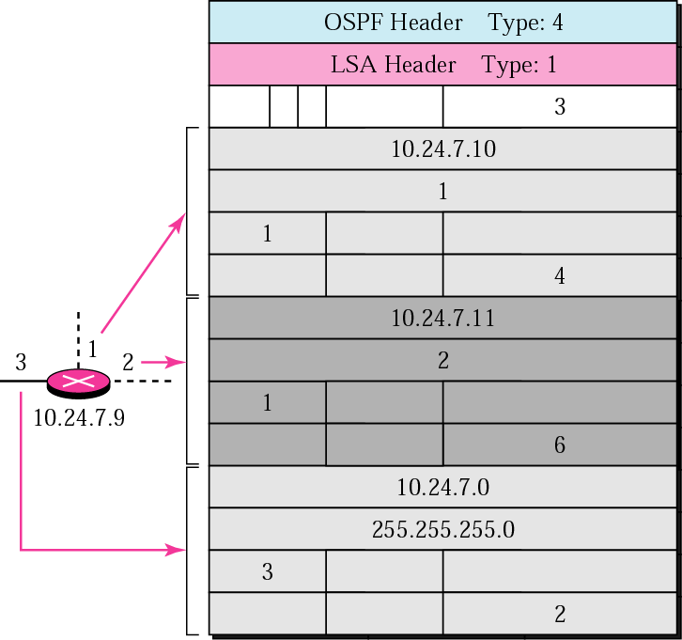
Figure 13-42
Solution to Example 5

Slide 60
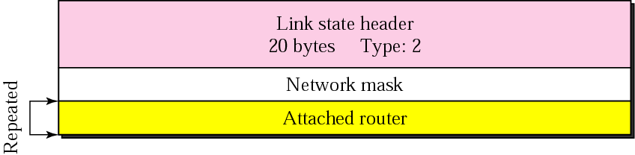
Figure 13-43
Network link advertisement format

Slide 61
Example 6
Give the network link LSA in Figure 13.44.

Slide 62

Figure 13-44
Example 6

Slide 63
Solution
The network, for which the network link advertises, has three routers attached. The LSA shows the mask and the router addresses. See Figure 13.45.
Note that only one of the routers, the designated router, advertises the network link.

Slide 64
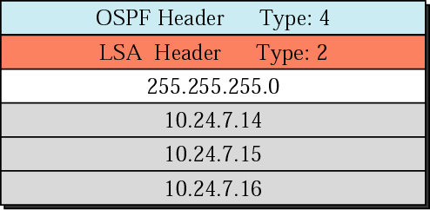
Figure 13-45
Solution to Example 6

Slide 65
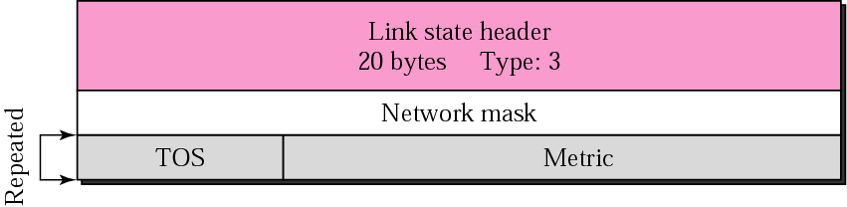
Figure 13-46
Summary link to network LSA

Slide 66

Figure 13-47
Summary link to AS boundary LSA

Slide 67
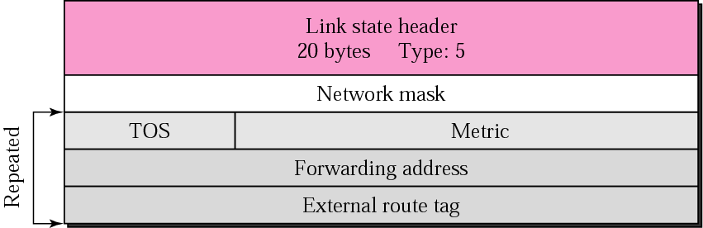
Figure 13-48
External link LSA

Slide 68

Figure 13-49
Link state acknowledgment packet

Slide 69
OSPF packets are
encapsulated in IP datagrams.

Slide 70
13.4
BGP:
Border Gateway
Protocol

Slide 71
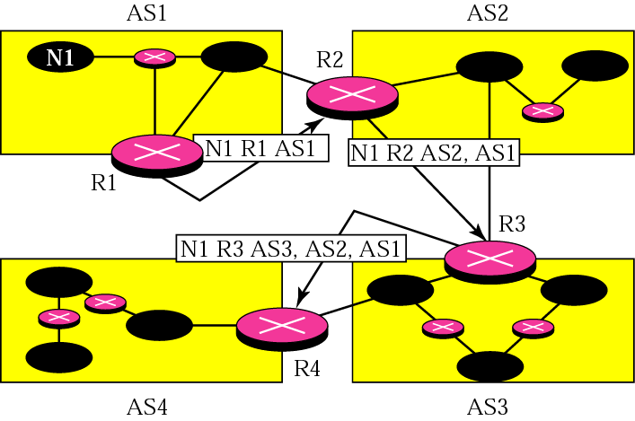
Figure 13-50
Path vector packets

Slide 72
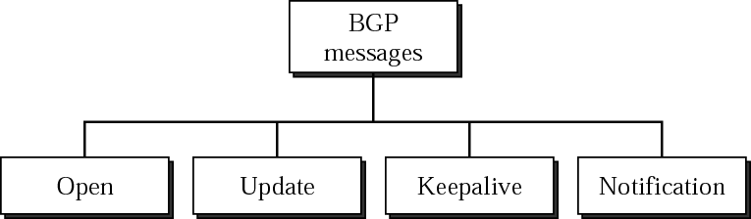
Figure 13-51
Types of BGP messages

Slide 73
BGP supports classless
addressing and CIDR.

Slide 74
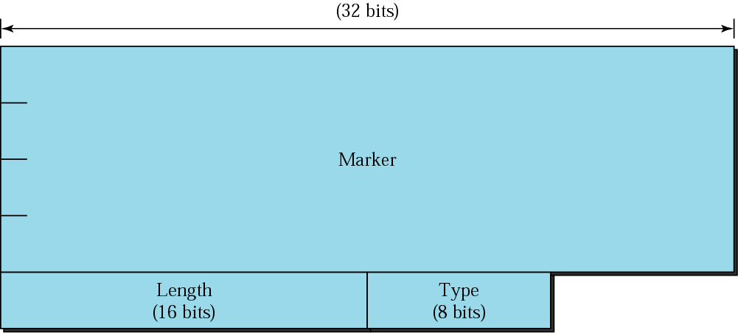
Figure 13-52
BGP packet header

Slide 75
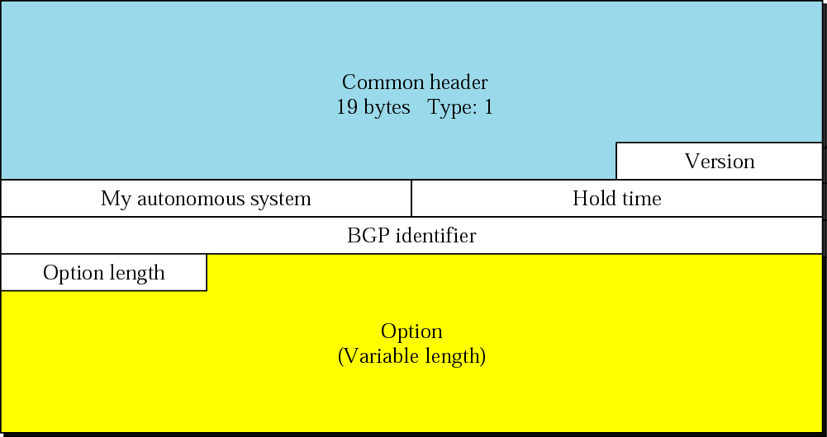
Figure 13-53
Open message

Slide 76
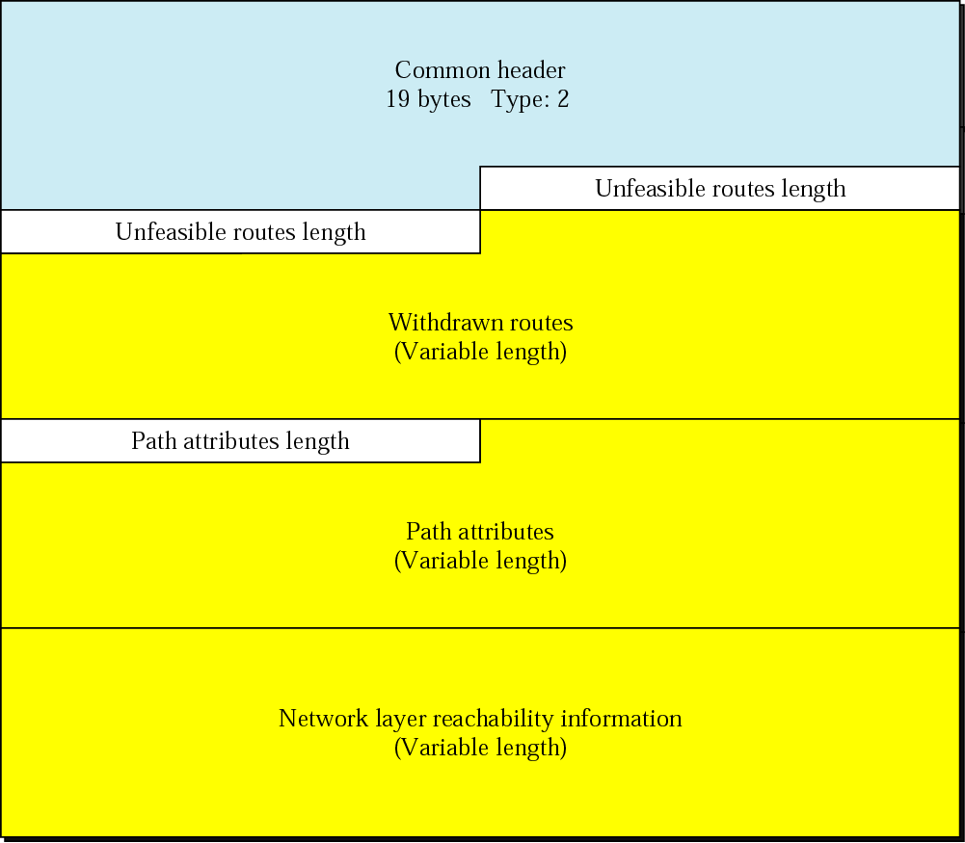
Figure 13-54
Update
message

Slide 77

Figure 13-55
Keepalive message

Slide 78
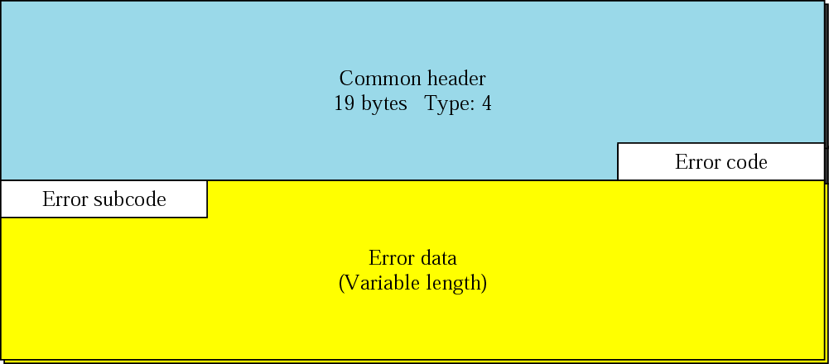
Figure 13-56
Notification message

Slide 79
BGP uses the
services of TCP on port 179.

